Slide 1

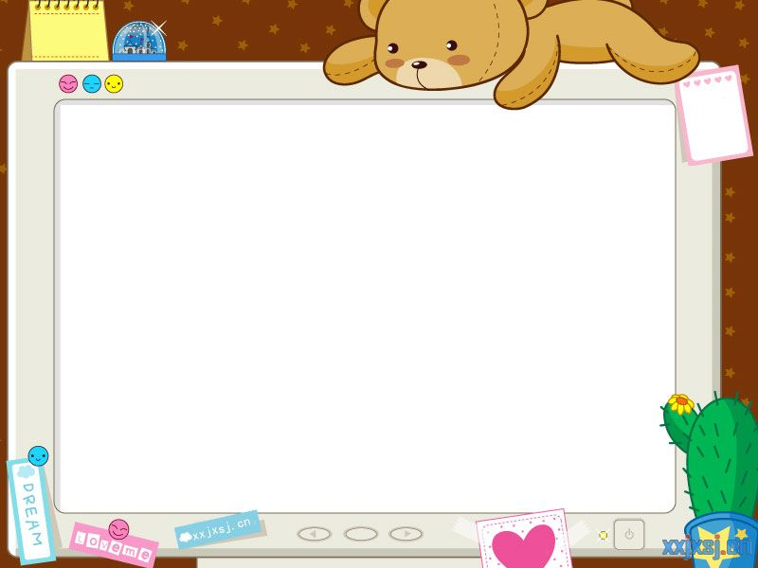
Ask a question, be a fool for a moment.
Don't ask a question be a fool for life.

Slide 2
To willingly undergo hardship
for the sake of helping
others is compassion.

Slide 3
We must carry out our tasks according to
principles, and not let our principles be
compromised by our tasks.

Slide 4
In handling matters, let your mind influence your heart,
in dealing with people,
let your heart influence your mind.

Slide 5
People don't leave organizations,
they leave leaders.

Slide 6
You will be judged by
your actions, not your
intentions.

Slide 7
Leadership is action,
not position.

Slide 8
Authority is a
poor
substitute
for leadership

Slide 9
Fail to honor people,
and they will fail to honor you

Slide 10
Blame softly,
praise loudly.

Slide 11
Even if you are on the right track,
you will get run over if you just sit
there

Slide 12
You can if you think you can

Slide 13
It is amazing what you can accomplish
if you don’t care who gets the credit

Slide 14
Be grateful for luck, but don’t count on it

Slide 15
The time is always right
to do what is right

Slide 16
There are no short cuts
to any place worth going

